Slide 1
Fundamentals Review Flex Session
Overview
In this lesson, students will review the Fundamentals unit and explore paths for continued development.
Duration 120 minutes
Learning Objectives
In this lesson, students will:
Review Python Fundamentals Lab Solutions
Recap concepts from Python Fundamentals

Slide 2
Pre-Class Materials and Preparation
For remote classrooms: Virtual breakout rooms and Slack may be needed to facilitate the partner exercise and discussions. As you plan for your lesson:
Consider how you’ll create pairs for the partner exercise (randomly, or with pre-assigned partners).
Determine how (if at all) exercise timing may need to be adjusted.
For helpful tips, keep an eye out for the For remote classrooms tag in the speaker notes.
Prepare screenshots and answers to exercises in advance so that they can be easily shared in Slack during your lecture.

Slide 3
Suggested Agenda
Time | Activity
0:00–2:00 | Python Fundamentals Unit Lab Solutions and Review

Slide 4
Jupyter Notebook
The exercises referenced in this lesson can be found in the Python Workbooks + Data folder.

Slide 5
Data Review and Next Steps

Slide 6
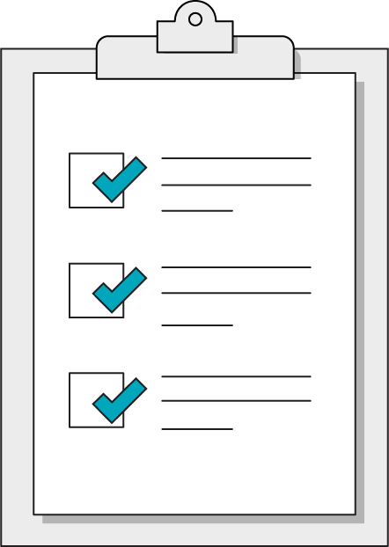
Today’s Learning Objectives
In this lesson, you will:
Review Python Fundamentals Lab Solutions
Recap concepts from Python Fundamentals
‹#› | © 2020 General Assembly
Notes:
Purpose: Set expectations for the lesson.
For remote classrooms:
Capture a screenshot of this slide and drop it in the class Slack channel.

Slide 7
Lab Review
Python Fundamentals Review Flex Session
Notes:
Duration: 15 minutes

Slide 8
Unit Lab Solutions and Review
2 hours
Let's review solutions for the Python Unit Labs by walking through the applications together.
Notes:
Take any questions about the Data Unit Lab.

Slide 9
Reflective Review of Python Fundamentals
Rate your confidence in the following statements so we can review concepts from Pandas as necessary:
I can operate a Jupyter Notebook file
I can create and manipulate variables of various data types
I can use lists and dictionaries to create complex data structures
I can use conditional logic to guide an application's logic
I can write problem-solving functions
I can import and use libraries
I can create useful python scripts to automate tasks
Notes:
Ask students to rate their confidence on a scale of 1-5, then take questions on the topics that get the lowest overall ratings.

Slide 10
Next Steps in Python
Python Fundamentals Review Flex Session
Notes:
Duration: 10 minutes

Slide 11
Data Analysis and Web Development
In the second half of this course, we will focus on two developmental paths using Python:
Data Analysis
We will use the Pandas library for exploratory data analysis
We will be able to generate insights and display them in data visualizations
Web Development
We will learn to use APIs to access and manipulate data from internet sources
We will use the Flask library to create web applications of our own

Slide 12

Don’t Forget: Exit Tickets!

